Slide 1

BMS Collecting Clamp

Slide 2
Content
Optional Variants of the Collecting Clamp
Explanation of the Differences Between the Clamping Automatics of the Collective Terminal:
  User-defined Clamping and Cutting by Control Column
  Clamping and Cutting Automatically Over Entire Pattern
  and
  Clamping and Cutting Automatically After Start and at Pattern End
  (default with new patterns)

Slide 3
User-defined Clamping and Cutting by Control Column
If the setting “User-defined Clamping and Cutting by Control Column” is enabled in configuration of the Collecting Clamp section, the user must enter all the information for controlling the Collecting Clamp himself:
- Clamp Home Position of Yarn Carriers
- Open Clamp
- Close Clamp
- Cutting
Table of Contents

Slide 4
Settings in Configuration below of the Variants of Clamping
The two entries below the clamping variants are evaluated for both clamping automations, but have no effect on user-defined clamping and cutting:
  Quantity of Rows Until Opening the Clamps:
  Opening of the clamps is delayed by the set quantity of rows. The opening is entered into the pattern at the same position, but it is delayed by the value in brackets.
  Quantity of Rows Until Closing Clamps After the Start
  Closing the clamps and cutting the threads is delayed by the set quantity of rows. The commands of clamping and cutting are entered into the pattern at the same position, but they are delayed by the value in brackets.
Table of Contents

Slide 5
Clamping and Cutting Automatically Over Entire Pattern
Division into Sections
Division into Sections:
With the clamping variant "Clamping and Cutting Automatically Over Entire Pattern", the pattern gets divided into three sections:
First Section: Start and the lower 25%
Second Section: Center 50 %
Third Section: Upper 25%
Table of Contents

Slide 6
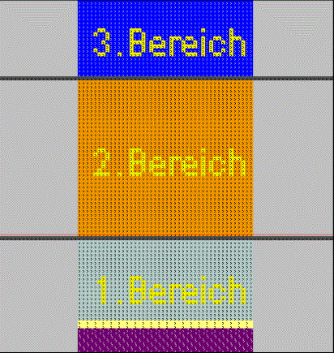
Clamping and Cutting Automatically Over Entire Pattern
Division into Sections
Fabric End
Intermediate clamping if necessary up to 75%
Clamping after waistband
or if necessary up to 25%
Table of Contents

Slide 7
Clamping and Cutting Automatically After Start and at Pattern End (Default)
Division into Sections
Division into Sections:
With the clamping variant "- Clamping and Cutting Automatically After Start and at Pattern End", the pattern gets divided into two sections:
First Section: Start and the lower 25%
Second Section: Remaining 75%
Table of Contents

Slide 8
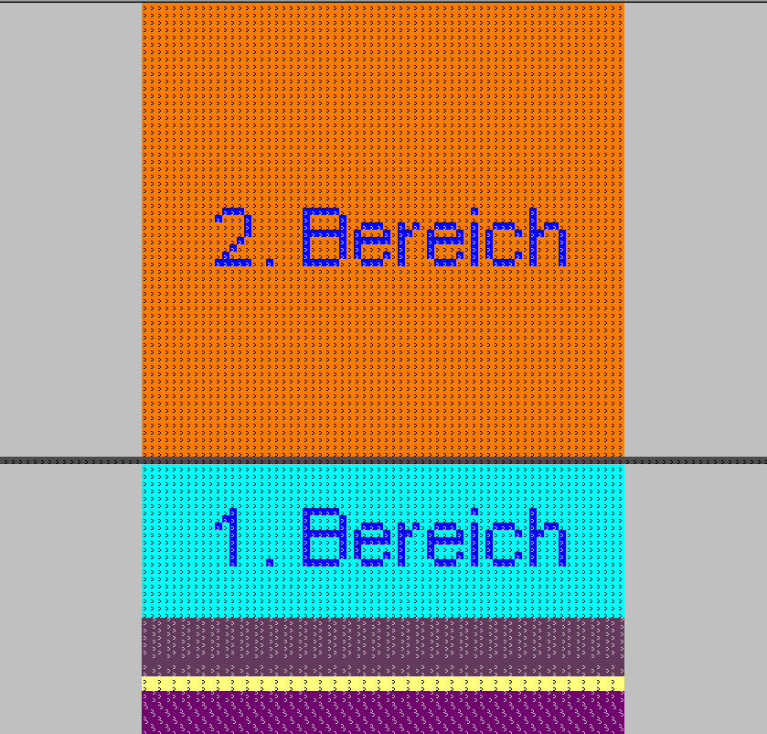
Clamping and Cutting Automatically After Start and at Pattern End
Division into Sections
Clamping at Fabric End
Clamping after waistband
or if necessary up to 25%
Table of Contents

Slide 9
What Both Variants of Automatic Clamping Have in Common
The following behavior is identical for both clamping variants
If only one yarn carrier is used above the start, all yarn carriers that are no longer needed are clamped to the left and right after the start.
If additional yarn carriers are used only in the first section of the pattern, they will be moved to the clamping home position (behind collecting clamp unit), clamped and cut together with the other yarn carriers of this side (comb thread, draw thread and possibly the rib thread).
If yarn carriers of the right and left side have to be moved to the home position, the clamping and cutting is moved upwards accordingly.
Table of Contents

Slide 10
Intermediate Clamping (pattern example 1)
Variant of Clamping: Clamping and Cutting Over Entire Pattern
If a yarn carrier ends in the middle 50% of the pattern, the so-called intermediate clamping is performed by this variant.
This means that the yarn carrier is automatically moved to the clamping home position after its last use.
The clamping after the waistband is done on the side on which the yarn carrier is located, not with the outer clamp as usual, but with the inner clamp, so that during intermediate clamping all thread guides that are behind the clamping/cutting unit can be clamped with the outer clamp.
Intermediate clamping is an additional clamping that is used, if necessary, between the clamping after the start (up to 25%) and the end of the fabric piece.
Table of Contents

Slide 11
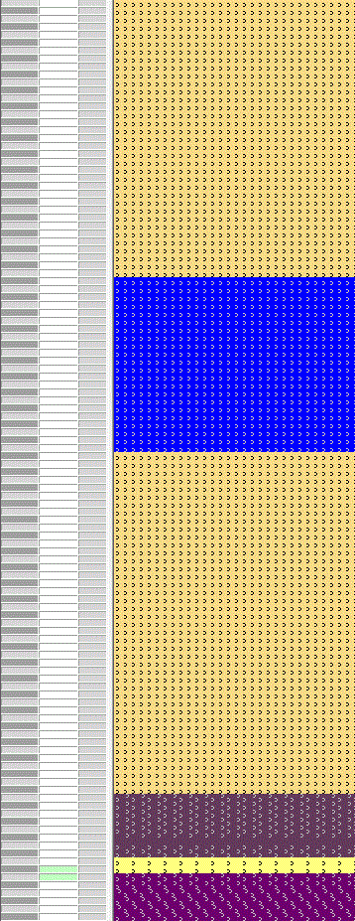
Intermediate Clamping (pattern example 1)
Variant of Clamping: Clamping and Cutting Over Entire Pattern
Basic Pattern
Table of Contents

Slide 12
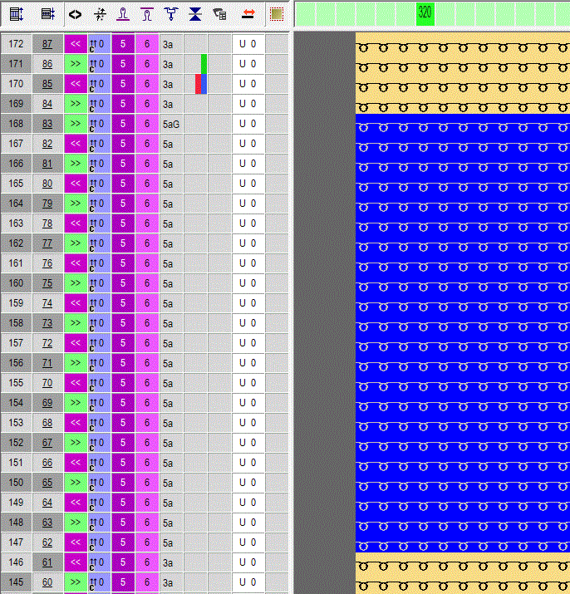
Intermediate Clamping (pattern example 1)
Variant of Clamping: Clamping and Cutting Over Entire Pattern
Commands of Clamping and Cutting
Table of Contents

Slide 13
Intermediate Clamping (pattern example 2)
Variant of Clamping: Clamping and Cutting Automatically After Start and at Pattern End
As this clamping variant only works with two sections (up to 25% and the end of the fabric piece), there is no intermediate clamping. All yarn carriers that are no longer used in the fabric piece after the first 25% are only clamped at the end of the pattern.
Table of Contents

Slide 14
Section 3 (pattern example 3)
Variant of Clamping: Clamping and Cutting Automatically Over Entire Pattern
If yarn carriers are only used in the upper 25% of the pattern, the following procedure applies to prevent the threads from winding at the belt take-down:
The yarn carriers are brought into the pattern by Float and Lock and clamped after the start. Before their usage in the upper section, they are fetched from the clamp again.
A typical example is the protection yarn. If the protection rows above are knitted with protection yarn, this is knitted at the start of the pattern. It is clamped after the waistband and fetched from the clamp at the end.
Table of Contents

Slide 15
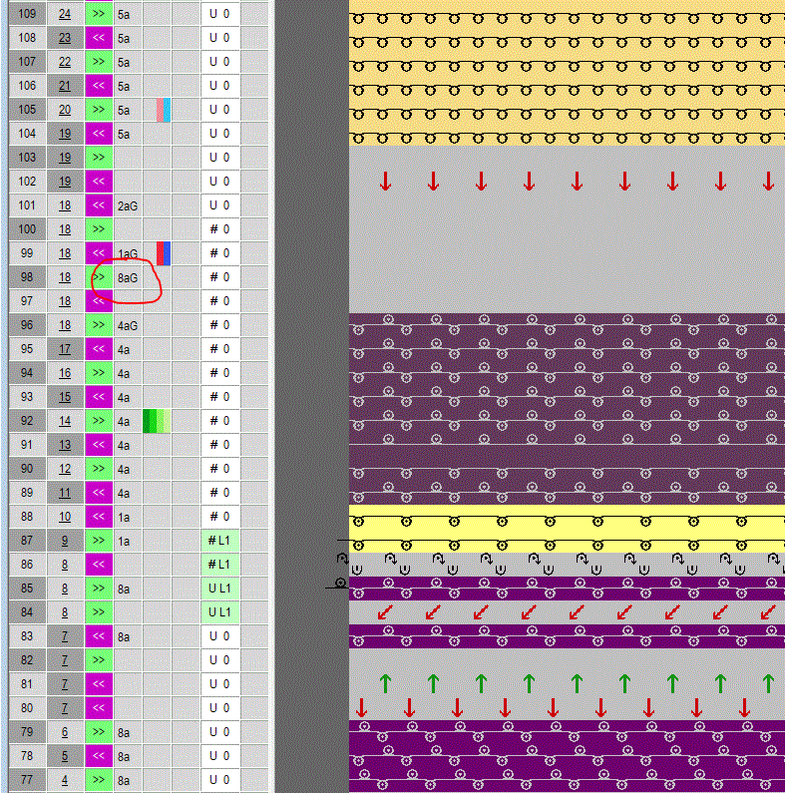
Section 3 (pattern example 3)
Variant of Clamping: Clamping and Cutting Automatically Over Entire Pattern
Example for Protection Thread Yarn Carrier 8A: After the waistband, the yarn carrier 8A will be moved behind the collecting clamp unit (clamping base position) [8aG]
Table of Contents

Slide 16
Section 3 (pattern example 4)
Variant of Clamping: Clamping and Cutting Automatically After Start and at Pattern End
As this clamping variant only works with two sections (up to 25% and the end of the fabric piece), all yarn carriers can only be clamped at the end of the fabric piece with it. In this case, the protective yarn carrier 8A would remain at the edge of the fabric piece and be fixed in the fabric by the automatic border fixation (on the CREATE PLUS).
Table of Contents

Slide 17
Variants of Automatic Clamping
If a variant of automatic clamping is used
Clamping and Cutting Automatically Over Entire Pattern
Clamping and Cutting Automatically After Start and at Pattern End
you can not intervene manually. Additional manual entries, for example after technical processing, can lead to errors in the Sintral Check.
Table of Contents

